Slide 1
Secure data hiding in images using steganography
CAPSTONE PROJECT
Presented By:
Student Name : pavada varun krishna teja
College Name & Department : kiet & mtech (cybersecurity)

Slide 2
OUTLINE
Problem Statement
Technology used
Wow factor
End users
Result
Conclusion
Git-hub Link
Future scope

Slide 3
Problem Statement
In the digital age, the need for secure communication has grown exponentially, especially for transmitting sensitive information in an inconspicuous manner. One of the effective techniques for this purpose is steganography, which involves embedding hidden data within an innocent-looking medium. Cryptography, which ensures the security of data, can enhance this method by providing encryption for the embedded information.
Problem Statement: Given a text message, design a cryptographic algorithm that encrypts the message and then embeds it into an image file. The system should ensure that the hidden message is:
Invisible to the Human Eye: The embedded text must not noticeably alter the appearance of the image, making it undetectable to the casual observer.
Encrypted for Security: The message must be encrypted using an appropriate cryptographic algorithm (e.g., AES, RSA) before embedding, ensuring that the text remains unreadable unless the recipient has the correct decryption key.
Reversible: The process of hiding the text should be reversible, meaning that the original text can be accurately extracted from the image without loss of data.
Robust against Detection: The steganographic method should minimize the chance of detection by automated steganalysis tools, which are designed to identify hidden information in images.

Slide 4
Technology used
code written in python
python library pillow used ( pip install pillow)
for creating used vscode
only works on windows

Slide 5
Wow factors
Aspects Are Somewhat Unique:
While least significant bit (LSB) steganography itself is common, the specific implementation of password hashing, robust error handling, and file format handling makes this code more functional and secure than many basic examples.
The combination of these elements produces a more practical and user-friendly steganography tool.
The main technique used for “encryption” is least significant bit (LSB) steganography. This involves modifying the least significant bit (the “1” or “0”) of the blue color component (or any other color component) of each pixel to encode a binary representation of the text (including the password hash). The data is then stored in the image as part of the pixel values, making it visually indistinguishable from a regular image.

Slide 6
End users
Steganography is used by a variety of end users, each with different purposes for hiding or securing information. Here are some key end users:
1. Government and Intelligence Agencies
Purpose: Secure communication for transmitting sensitive data covertly, often to avoid detection by adversaries or surveillance systems.
Example: Embedding classified messages within publicly available digital media to prevent interception.
2. Cybersecurity Experts
Purpose: Enhance data privacy, secure communications, and prevent unauthorized access to sensitive information by embedding it in innocuous files.
Example: Securing confidential company data or communications during a cyber investigation.
3. Hackers and Cybercriminals
Purpose: Use steganography for malicious activities, such as hiding malware, exfiltrating stolen data, or coordinating attacks covertly.
Example: Hiding commands or malware inside images or audio files to bypass security filters.

Slide 7
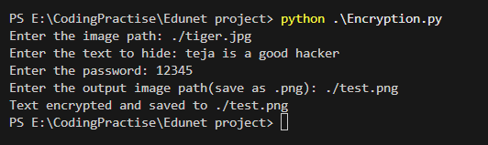
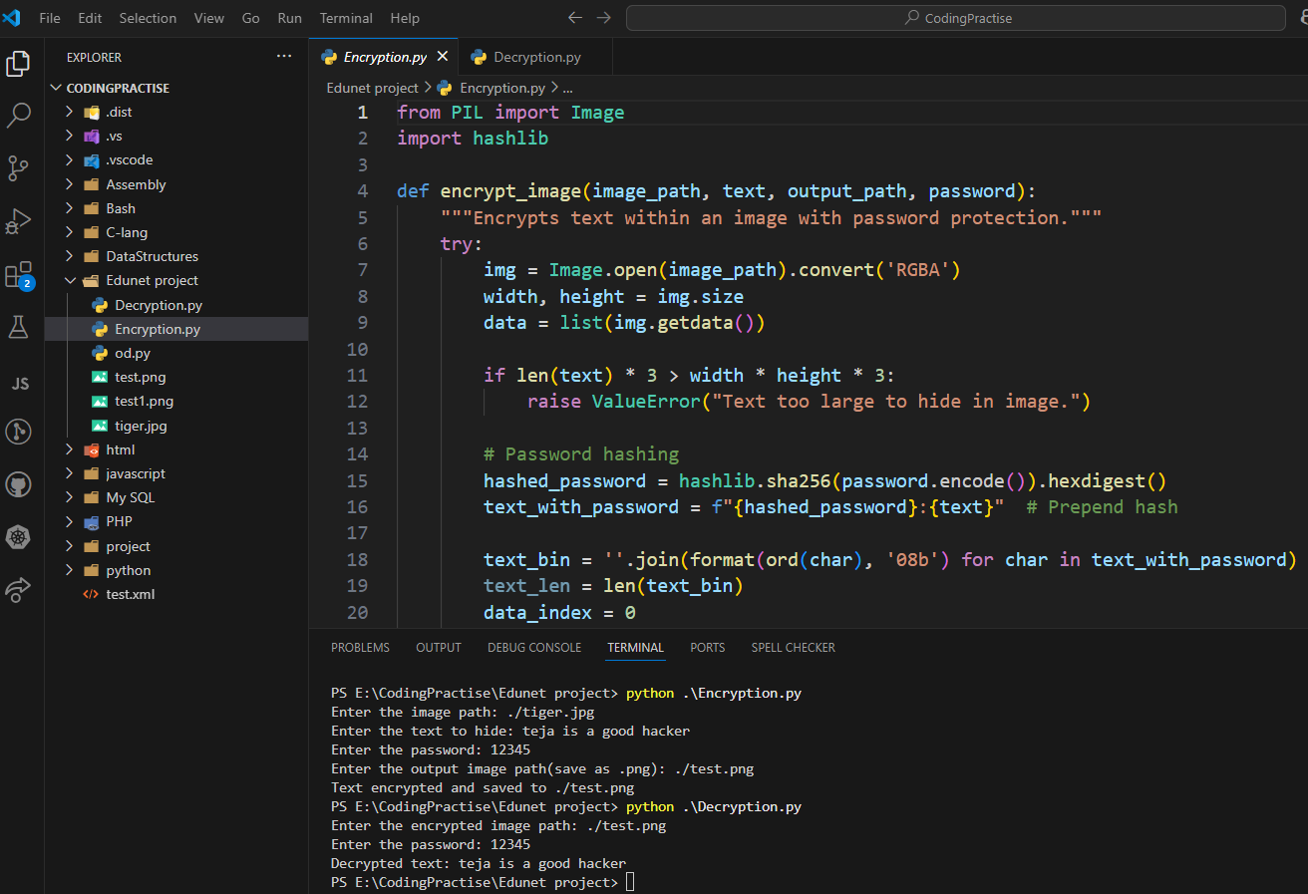
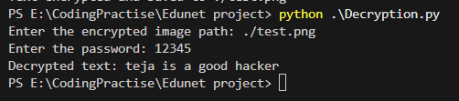
Results
Encryption :
Decryption :

Slide 8
Conclusion
In conclusion, steganography offers a powerful method for securely hiding data within digital media, ensuring confidentiality and privacy. It plays a crucial role in various fields, including cybersecurity, government communications, and personal privacy, by enabling covert information transmission. While it presents challenges in terms of detection and efficiency, ongoing advancements in technology continue to improve its effectiveness and security. As the demand for secure communication grows, steganography will remain an essential tool for protecting sensitive information in an increasingly digital world.

Slide 9
GitHub Link
https://github.com/pvkt/Stegnography
https://github.com/pvkt/Stegnography/blob/main/README.md

Slide 10
Future scope(optional)
future scope of steganography:
Enhanced Detection Resistance: Developing more advanced steganographic methods that are harder to detect by automated tools and forensic analysis, increasing the robustness of hidden data.
Integration with Cryptography: Further combining steganography with strong encryption techniques to create secure, privacy-preserving communication channels for individuals and organizations.
Adaptive Steganography: Creating dynamic and context-aware steganographic techniques that adapt to different media types (images, videos, audio) and hide data in a manner less detectable by evolving detection algorithms.
Steganography in Blockchain and Cryptocurrency: Utilizing steganography for secure, decentralized communication within blockchain environments and cryptocurrencies, adding an extra layer of anonymity.
Real-Time Data Hiding: Developing steganographic solutions for real-time communication (e.g., live video streaming) to enable the secure, covert transfer of information during ongoing digital interactions.
AI-Driven Steganography: Leveraging artificial intelligence to enhance the efficiency, intelligence, and adaptability of steganographic algorithms, making data hiding more robust and scalable.
Large-Scale and High-Capacity Steganography: Improving methods for hiding larger volumes of data in digital media without compromising the quality of the cover medium, making steganography more practical for use in complex environments.
Steganography for IoT Devices: Developing lightweight steganographic techniques to fit the resource constraints of IoT devices, allowing secure communication in smart networks.

Slide 11
THANK YOU

